Slide 1
Development of Artificial Robotic Arm based on Tactile Sensor
Internship at Biorobotics Institute, Pisa, Italy

Slide 2
Team
Mentor:
Prof. Calogero Oddo
Vinit Sarode
Sapan Agrawal
Notes:
The Biorobotics Institute: http://www.santannapisa.it/en/institute/biorobotics/biorobotics-institute
VNIT Nagpur: http://www.vnit.ac.in/
Prof. Calogero Oddo: http://sssa.bioroboticsinstitute.it/user/102

Slide 3
Cyberphysical Architecture
Environment
ARM Cortex A-9 Processor
Air Cylinder
Festo Pneumatic Muscles
Air
Pressure Controller
Air
Tactile Sensor
Power System

Slide 4
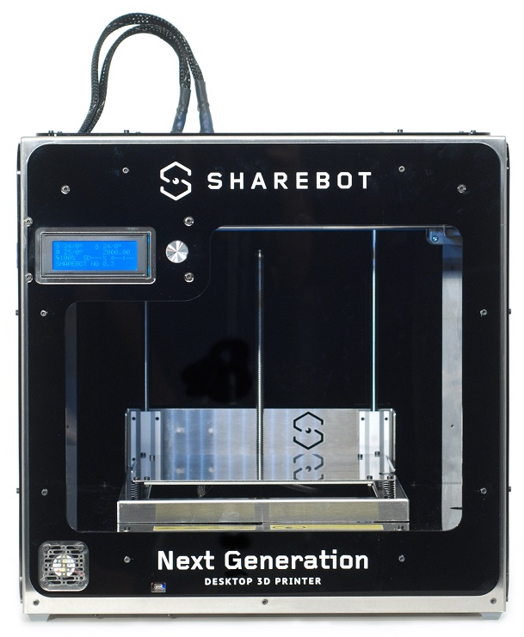
3D Printing Technology
To produce stronger and lighter parts quickly.
To reduce the part manufacturing cost.
To produce multiple part prototypes easily and independently.
Available Printer Technologies:
FDM (Fused Deposition Modelling)
SLS ( Selective Laser sintering)
DLP (Digital Light Processing)

Slide 5
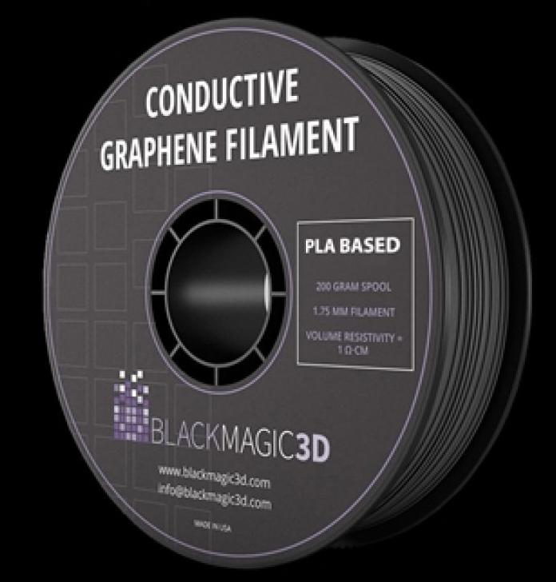
Use of Graphene in 3D Printing
Enhances the mechanical strength , thermal and electrical conductivity.
Used in developing batteries, Sensors, EMI and radiofrequency Sheets.
Used for conductive paths which could be directly printed in the parts.
Notes:
https://3dprintingindustry.com/news/what-can-we-3d-print-with-graphene-filament-56303/

Slide 6
Graphene Filament Manufacturers
Afinia Graphene Enhanced PLA ( 50$/400gm)
BlackMagic3D HIPS Carbon Fiber Graphene (40$/350gm)
Conductive Graphene PLA Filament (55$/100gm)
Grafylon PLA+Graphene (19.32$/350gm)
GraphenePLA (23$/500gm)

Slide 7
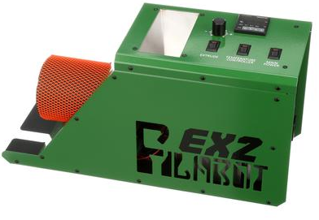
Filament Production
Can produce both 1.75mm and 2.85 mm filament.
Can be used to recycle the waste printed materials.
Heating the mixture of Graphene and Pellets will form the composite which can be then shredded and fed to the Filabot.
Filabot Filament Extruder

Slide 8
Strength & Ductility Enhancement
Benefits of cementitious composites: enhancement in strength, ductility, fracture energy by incorporating micro-sized inert carbonized particles in cementitious composites.
0.08 wt.% addition of micro sized inert carbonized bamboo particles enhances the flexural strength and toughness up to 66% & 103% resp. of cement composites.
Cement composites are the heterogeneous materials composed of complex micro, mezzo and macro structure.
Increased w/c (water-cement) ratio reduces the mechanical strength of C-S-H (Calcium silicate hydrate) at nano scale and consequently results in lower strengths of cement composites.
Literature shows that the use of fly ash, silica fume, ground granulated blast furnace slag, lime stone powder, bentonite, metakaolin, glass powder, rice husk, coconut shell and wheat straw ashes in the cementitious composites as a partial replacement of cement have several positive effects on their performance, such as improved workability, consistency, thixotropy, compressive strength and durability.

Slide 9
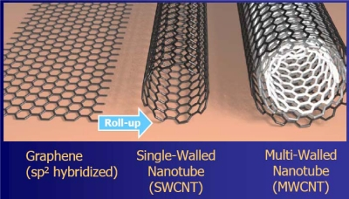
Need of CNT and Graphene Nanocomposites
Degradation of High temperature mechanical properties.
Low fracture toughness.
Poor creep
Deprived thermal shock resistance.
Notes:
CES :https://www.youtube.com/watch?v=nbuu7UD2GVk
Reference: Recent Advances on Carbon Nanotubes and Graphene Reinforced Ceramics Nanocomposites.

Slide 10
Graphene Reinforced Ceramic Nanocomposites
For bulk engineering, few layered graphene platelets including reduced graphene oxide (GO) are more economical and viable.
Mechanical Clevage Method and Hummers method are used to obtain graphene ceramics mixture.
GNP’s (Graphene Nano Platelets) have better dispersion due to less van der Waal's forces, high specific area and 2D geometry.
Colloid Processing using anionic and cationic surfactants (to alter charge on GNPs and opposite material) is preferably used dispersion technique.
The graphene securely anchors around the base material, thus requires high pulling out energy than CNTs.

Slide 11
Benefits of GNP
Enhances mechanical performance (235% facture toughness in Al2O3).
Improves wear resistance.
Stabilizes base material thermally and chemically.
Increases the thermal conductivity.
Converts base material into a functional material like sensors, electric shielding, electrodes, conducting paths, etc.

Slide 12
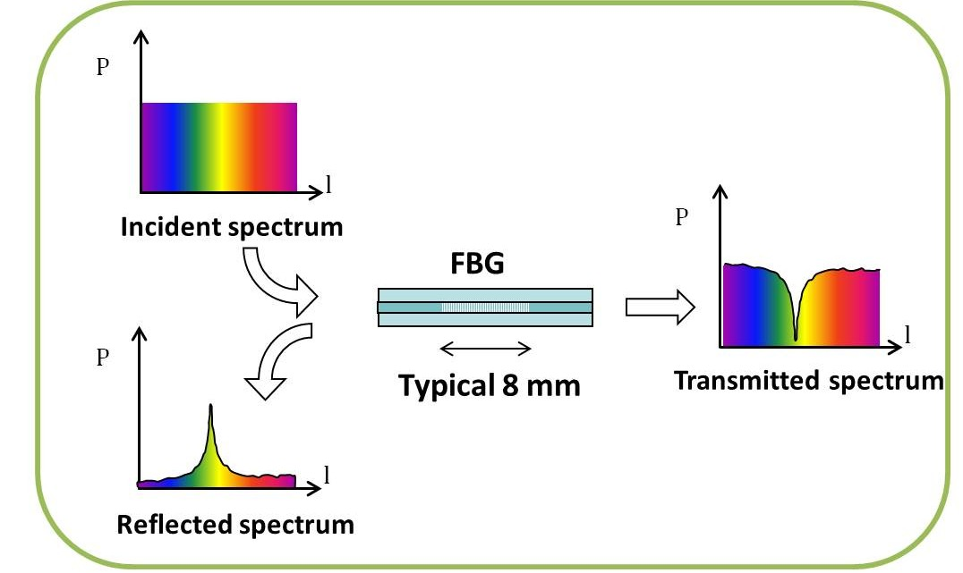
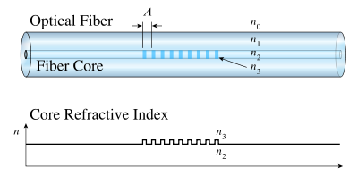
Fiber Bragg Grating (FBG) Principle
FBG is a short segment of optical fiber that reflects a particular wavelength of light and transmits the rest.
The periodic refractive index (RI) of Germanium doped silica fiber is obtained by exposing UV light ( function of intensity and duration).
The FBG works on the principle of Fresnel Reflection where the light travelling between media of different RI may both reflect and refract.
The central wavelength of the reflected one is the Bragg’s wavelength which depends on the spatial grating period.
The grating Length changes w.r.t strain induced in the FBG and the change in temperature.

Slide 13
Benefits of FBG:
1. It avoid issues related to light intensity
2. Fast response
3. Negligible hysteresis
4. Possibility to discriminate uniform & non-uniform load adapting FBGs with special design.

Slide 14
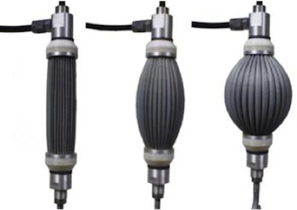
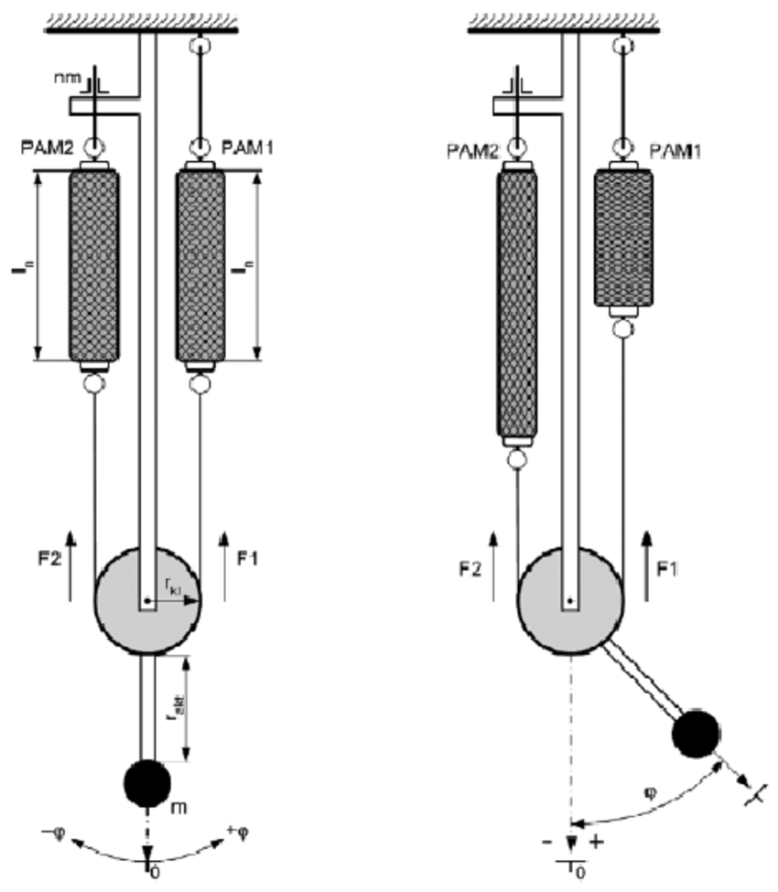
Actuators
Pneumatic Artificial Muscles (PAM) are contractile or extensional devices operated by pressurized air filling a pneumatic bladder. (Also known as McKibben Artificial Muscles)
They are usually grouped in pairs of agonists and antagonists.
The muscles consist of an inflatable inner tube/bladder inside a braided mesh, clamped at the ends. When the inner bladder is pressurized and expands, the geometry of the mesh acts like a scissor linkage and translates this radial expansion into linear contraction
Notes:
https://www.festo.com/cat/en_us/products_010606

Slide 15
Benefits of PAM
Lightweight (due to use of thin membrane)
Compliant behaviour (When a force is exerted on PAM, it “gives in” , without increasing the force in actuation.)
Relationship between force & extension in PAMs and length-tension relationship in biological muscle systems are very similar.
Force in them is not only dependent on pressure but also on their state of inflammation.

Slide 16
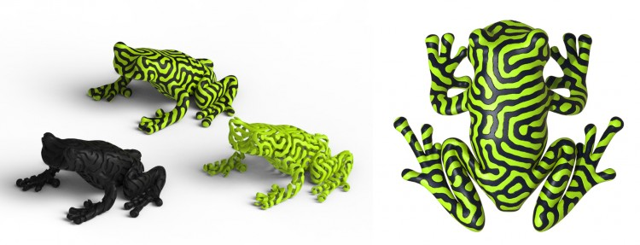
Reaction- Diffusion by Nervous System

Slide 17
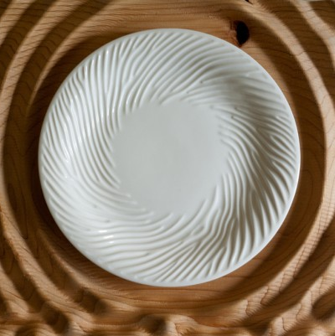
Reaction- Diffusion by Nervous System [Link]
The strip pattern was generated using simulation of reaction – diffusion, a mathematical model that can be used to simulate the skin patterns of various animals.
The firm now uses the technique commercially to make anticraft and jewelry.
[Video Link 1]
[Video Link 2]

Slide 18
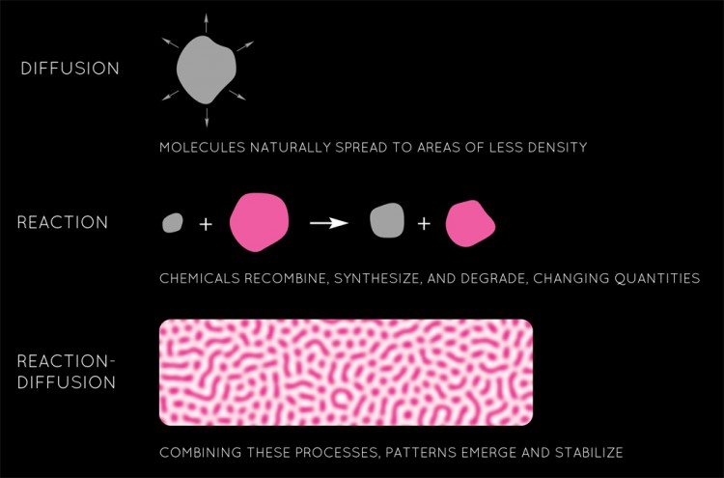
Reaction- Diffusion by Nervous System

Slide 19
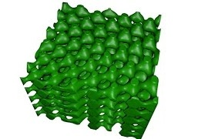
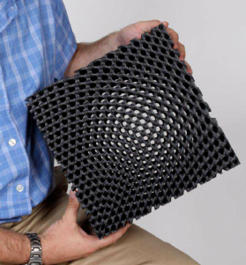
3d Spatially Variant lattices
Algorithm to spatially vary and functionally grade all of the attributes of a periodic structure independently and simultaneously while still rendering the overall lattice smooth and continuous.
Attributes include unit cell orientation, lattice spacing, fill fraction, geometry, material composition, and more.
It is still in research phase at University of Texas at El Paso by EMLab. They are using MATLAB to develop lattices and Blender software to give them the desired shapes.
http://emlab.utep.edu/research.htm
[Video Link 1]
[Video Link 2]

Slide 20
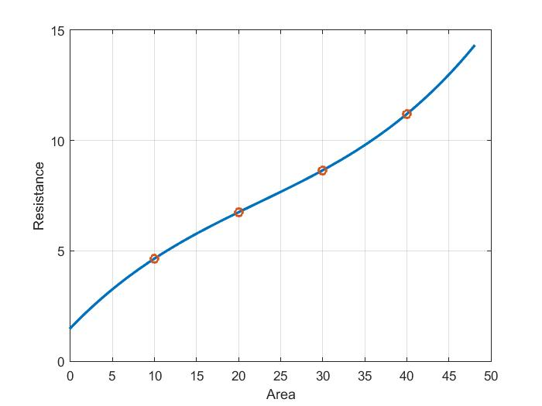
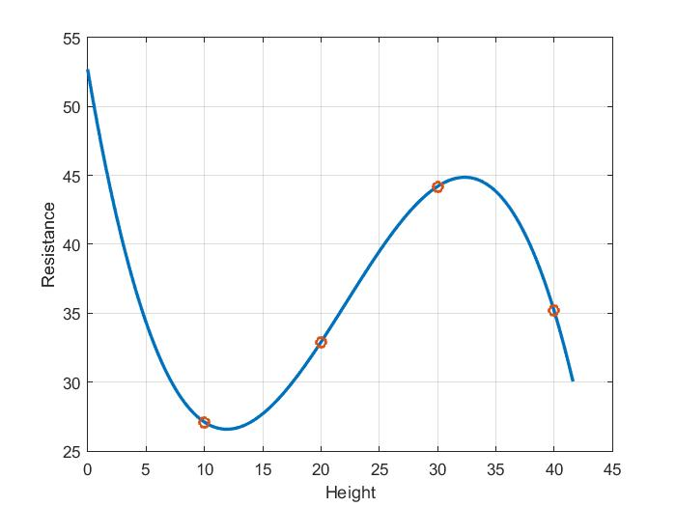
Resistivity Measurement
Length | 4mmX8mm (in Ω)
10mm | 4.65
20mm | 6.75
30mm | 8.65
40mm | 11.2
Height | 4mmX8mm (in Ω)
10mm | 27.1
20mm | 32.9
30mm | 44.2
40mm | 35.2

Slide 21
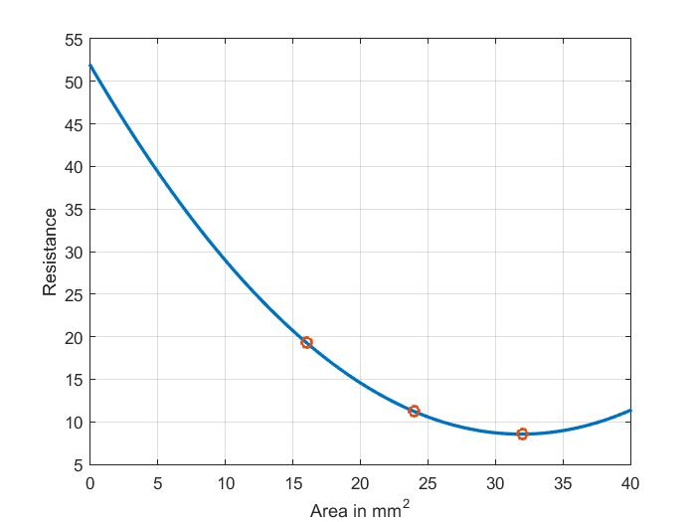
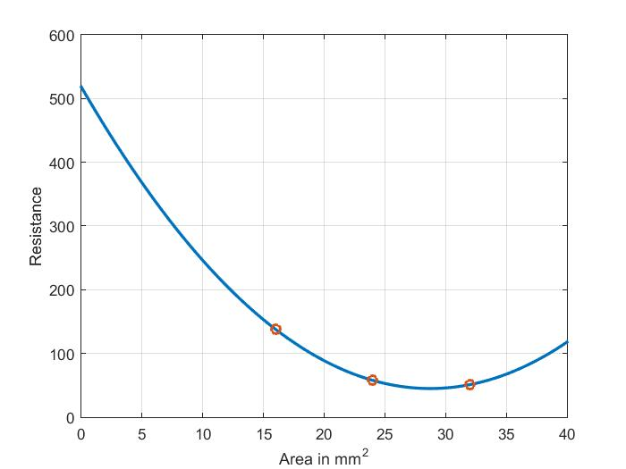
Variation in Area of Cross Section
Area | 30mm (Length) (in Ω)
4mmX4mm | 19.3
4mmX6mm | 11.2
4mmX8mm | 8.55
Area | 30mm (Height) (in Ω)
4mmX4mm | 137.85
4mmX6mm | 57.8
4mmX8mm | 51.1

Slide 22
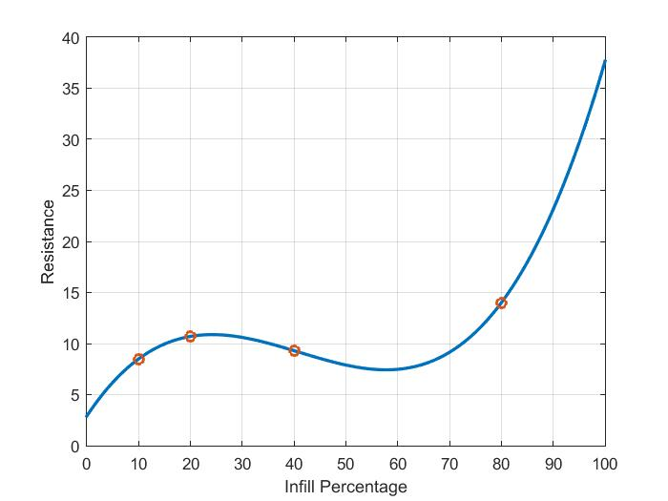
Variation in Infill Percentage
Infills | 4mmX8mm (in Ω)
10% | 8.5
20% | 10.7
40% | 9.3
80% | 14

Slide 23
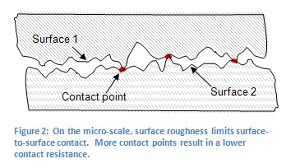
Contact Resistance
The effect of contact resistance was immediately seen when the resistance of graphene composed PLA was measured using multimeter.
The contact resistance comes into play due to smaller area of intimate contact between the two surfaces.
The fluctuation was observed due to the contact resistance being comparable to the resistance being measured.
The contact resistance can be reduced using the Silver Conductive Paint.

Slide 24
Joint Limits
Sr. No. | Action | Muscles |  | Min Length (Contraction) | Upper Limit | Lower Limit
 |  | Agonist | Antagonist
1. | Shoulder Abduction/Adduction | Deltoid |  | 200mm (50mm)
2. | Shoulder Flexion/Extension
3. | Medial/Lateral Rotation
4. | Elbow Flexion/Extension
5 | Pronation/ Suppination

Slide 25
Queries
1. Why Graphene?
(It is used for the purpose of conduction. Alone graphene is almost 10 times stronger than stainless steel. But graphene composites are not that strong but still the 3d printed parts using graphene composites will have more strength than those printed with PLA and ABS.)

